Slide 1

Model Writer
Use case and exploitation prospects: Use cases FR-03 & FR-04
Anne MONCEAUX
Airbus Group Innovation
Louis ROUCH, Ayhan MOHOVIC
Airbus SAS

Slide 2
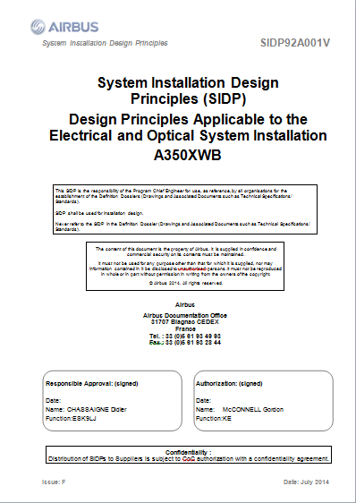
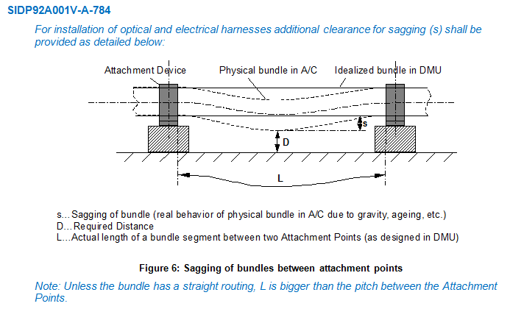
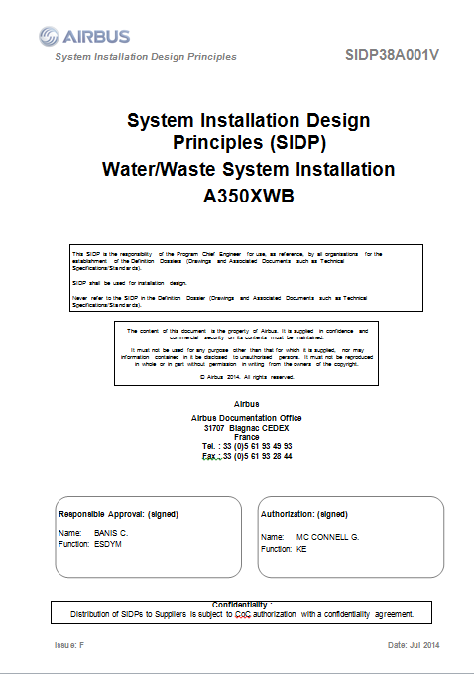
SIDP: “System Installation Design Principles”
Notes:
SIDP is used (under Non Disclosure agreement) as a use case

Slide 3
Context and problem
SIDP documents explain how to install the aircraft systems and attach them to the structure. They capitalize the best practices & proven technical solutions.
SIDP are defined per ATA chapter (~functional domain) to be applied for each given A/C project: for example “A350 Electrical installation”
SIPD are open to Extended Enterprise: installation tasks are performed by risk sharing partners.
SIDP are living documents: during the aircraft development any new DP allowing to satisfy all targets/constraints can be added, assuming it is validated by Airbus dedicated committee.

Slide 4
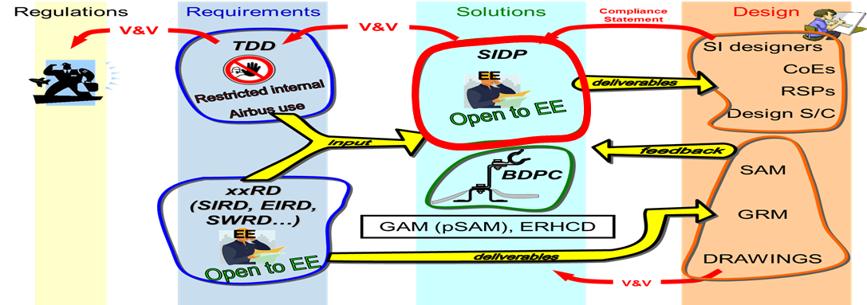
Context and problem
Both authoring & maintenance and usage of SIDP by the designers are difficult and time consuming.
“Document update lead-time is high (several months)!”
“Suboptimal usage of SIDP by RSP due to volume & complexity of the documentation!”
➔ Airbus started the creation of a SIDP database which current scope (mid-2015) covers parts of existing SIDP documents.
Notes:
Comment: Suboptimal usage worsened by the high labor turnover and subsequent missing experience encountered in risk sharing partners (RSP) system installation staff (main A350 assumption was that almost 100% of system installation will be done by RSPs).
Some needs = Improve SIDP creation, maintenance and consultation in order to:
OK: save costs by supporting DP consultation / retrieval in accordance to the needs
OK: avoid non-compliance of design caused by DP updating lead times
OK: keep traceability with upstream regulations and requirements and downstream design models

Slide 5
Industrial high level needs
To improve SIDP creation, maintenance and consultation in order to:
save costs by supporting DP consultation / retrieval in accordance to the needs
avoid non-compliance of design caused by DP updating lead times
keep traceability with upstream regulations and requirements and downstream design models

Slide 6
Synchronization of regulation documentation with a design rule repository

Slide 7

UC-FR-03 Synchronization of regulation documentation with a design rule repository
Goal: synchronizing the SIDP database content with documentation
Create links between text fragments & model elements (manual annotation?, semi-automatic?…)
Manage consistent synchronization (manage changes)

Slide 8
UC-FR-03 Synchronization of regulation documentation with a design rule repository
Approach: limited case on Electrical Installation functional domain
(Confidential Data - Non Disclosure Agreement finalized in June 2015).
Text
1 document: SIDP ATA 92
In our industrial context SIDP are edited using MSWord
Models
An OWL model is built that reflects the DB schema: “Rule ontology” (30 classes, 35 object properties and 54 data properties)
Automatic population mechanism of the model from a csv BD export produces the KB (45781 triples)
Notes:
Why an OWL model?
- Natural

Slide 9
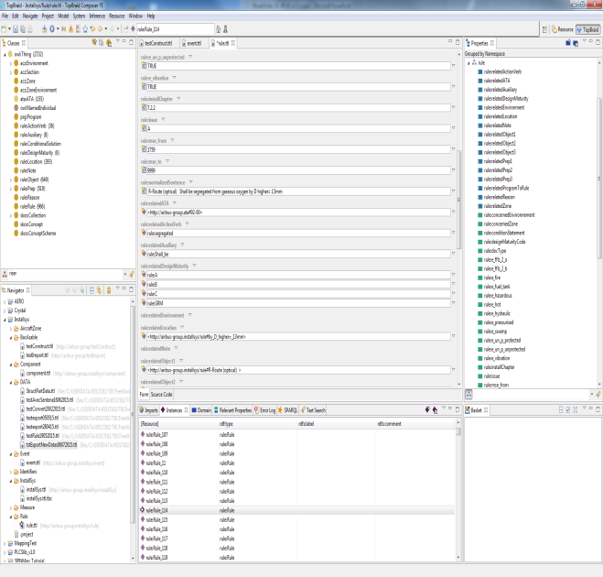
UC-FR-03 Synchronization of regulation documentation with a design rule repository
Status 1st iteration: synchronizing the SIDP KB content and text part
Thermal variation shall be taken into account
Structural deformation shall be taken into account
Pressurization Variation shall be taken into account
Component/Item/Object shall be qualified to withstand temperature reached by the routes they are in contact with
Model part = rule KB
Textual part = rule sentences

Slide 10
Production of a context specific design document

Slide 11
UC-FR-04 Production of a context specific design document
Goal: producing document according to usage “needs”
Produce “filtered” document with subset of Design Principle textual elements according to usage “needs”

Slide 12
UC-FR-04 Production of a context specific design document
Approach:
use case Electrical Installation functional domain
Confidential Data - Non Disclosure Agreement finalized in June 2015
Use model elements to retrieve relevant Design Principles
Text
1 document: SIDP ATA 92
In our industrial context SIDP are edited using MSWord
Models
The previous Rule KB (populated Rule ontology)
Component ontology (476 classes, 21 ObjectProperties and 35 DataProperties)
Notes:
Why an OWL model?
- Natural

Slide 13
Component classes taxonomy
ObjectProperties
Component
Assembly
“Structural_Element”
subClassOf
“Bracket”
Physical component
Attachment device
“Fastener”
“Pclamp”
Clamp
AnnotationProperties
Rdfs:label
“Assembly”
Skos:prefLabel
P-Clamp
P-Clamp NSA5516

Slide 14
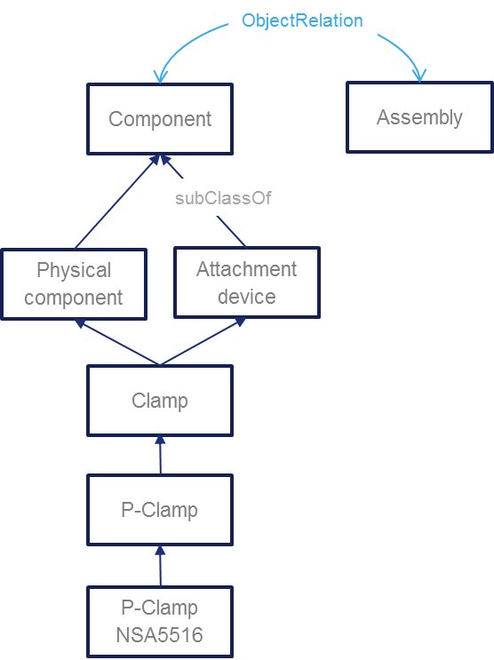
Component classes taxonomy
“P-clamp NSA5516 can be fixed on X with Y”
“Physical component”
“Standard reference”
NLP Parsing uses this taxonomy. Labels + assumptions such as a physical component may be referred to using its name or its reference or both concatenated
Inference rule: a rule applying to a component type (Attachment device) applies to its subtypes (P-clamp)
Document display : when searching rules applying to a component type (P-Camp) → retrieve and display rules applying to super-types

Slide 15
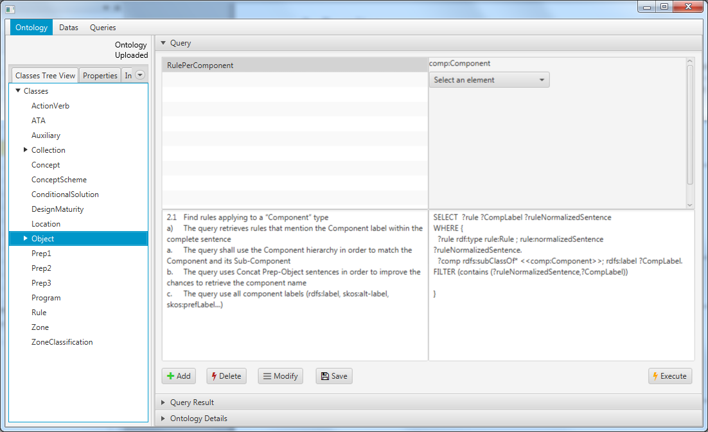
SPARQL queries
Status : model based queries specification
Preliminary study with Loria (Text to RDF)
1 internship on RDFizer and Query management

Slide 16
Thank you for your attention! Any question ?

